Slide 1


Slide 2


Slide 3


Slide 4

Make a first step in IT as a Business Analyst

Slide 5

Who is Business Analyst?

Slide 6
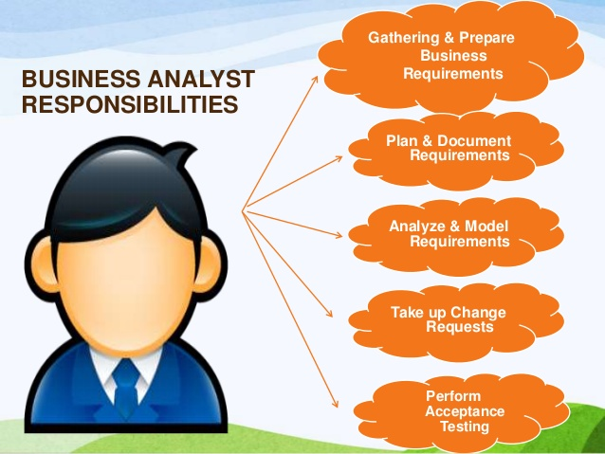

Slide 7

PRE-REQUISITE

Slide 8
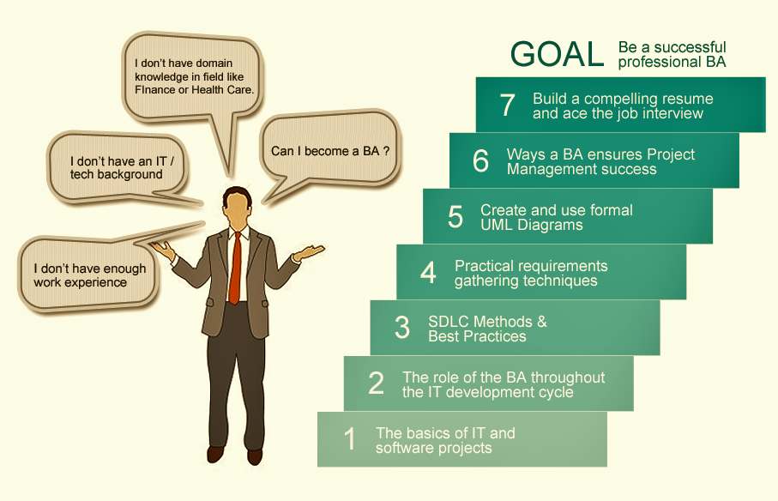
Our Training Ladder

Slide 9

Business Analyst training
Domain Knowledge
Resume Preparation
Interview preparation
Job Placement
On the job support

Slide 10



How we teach
Classroom training
Get Reading Material
Create documents(BRD,FRD)
BA case study practice
Learn BA tools
Receive Mock Interviews

Slide 11

Training Duration
2-3 months
4 Days class per week
10-12 weeks
225 hours

Slide 12

What you can expect to learn
Introduction to business Analysis
Software Engineering process
Requirement Gathering Methodologies
Requirement Gathering documents
Use Cases
Unified Modeling Language
Business Analyst software’s Hand-on Learning

Slide 13
Why IDEAL?
Courses Designed with the end goal in mind
Real life project examples
Emphasis on practical training
Free placement assistance
On the job life-line support

Slide 14

Work with us for job search
Contract Position
Contact to permanent position
Permanent position
Part time position

Slide 15
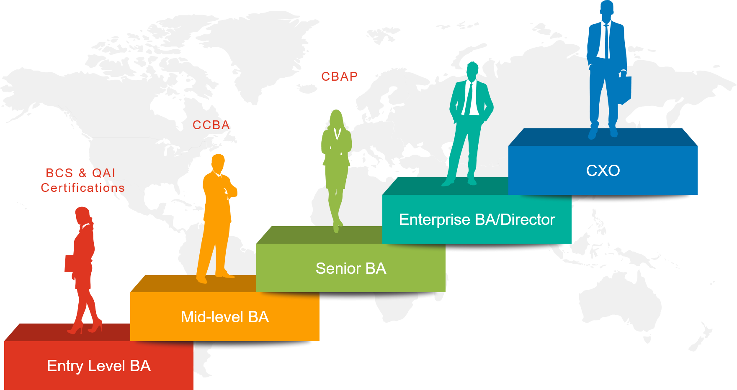
How to grow as a BA

